Slide 1

[GPC-510]
Course Instructor: Dr. Partha Pratim Mandal
Group Members
Vanisha Vashishtha(22MC0109)
Susovan Das(22MC0101)
Ravi Tej(22MC0070)
Lavudya Rajender(19JE0476)
.

Slide 2
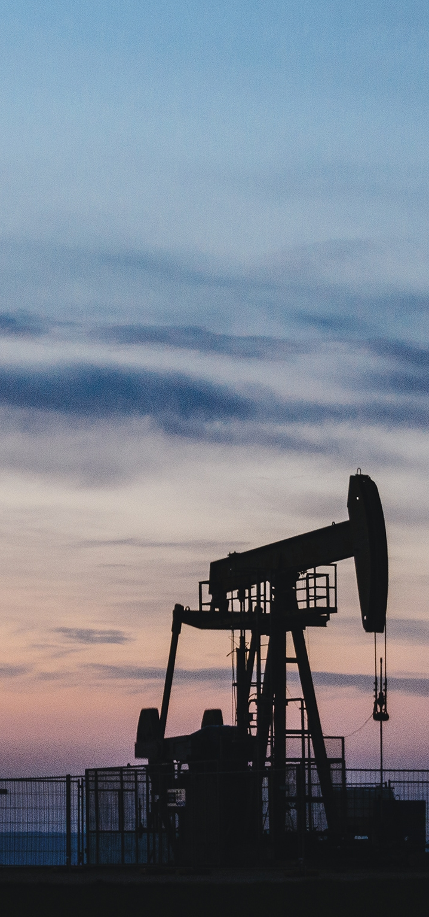
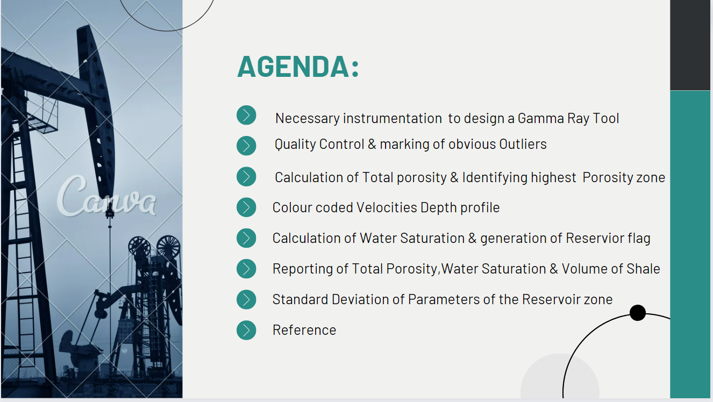
.
.

Slide 3
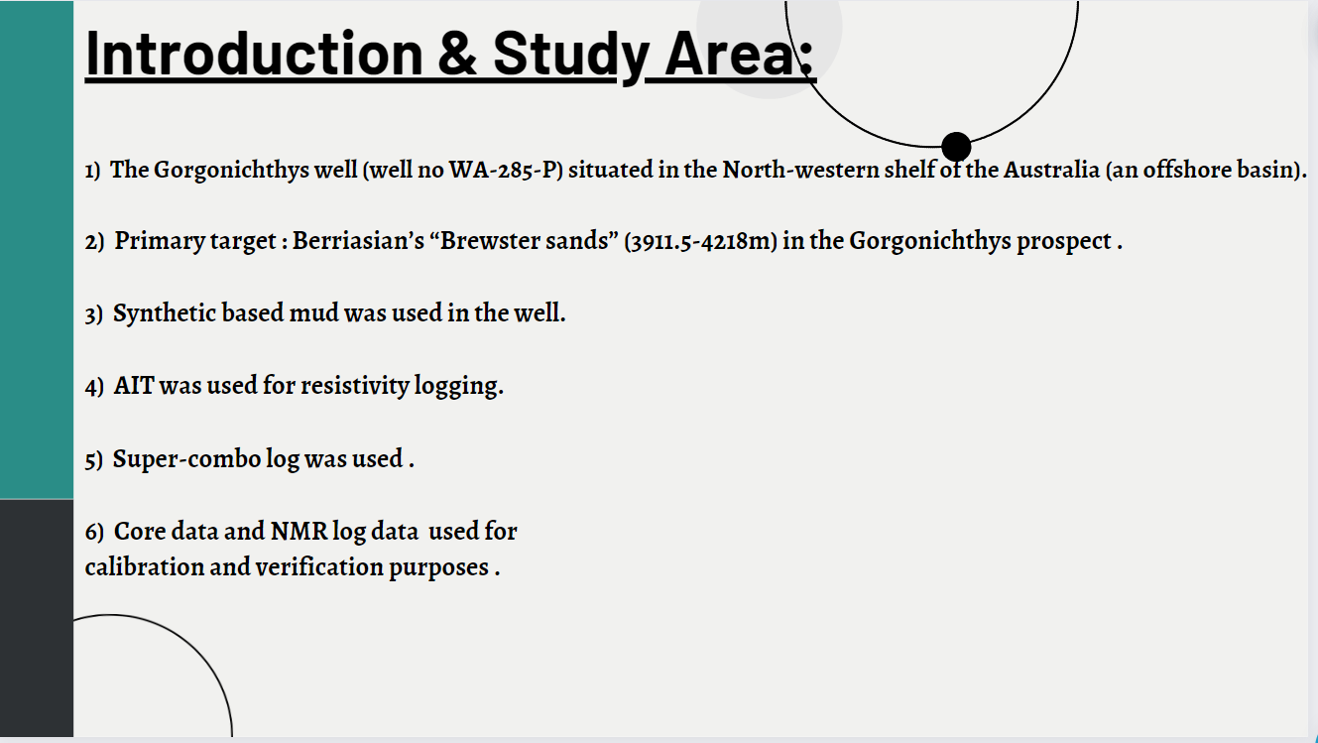
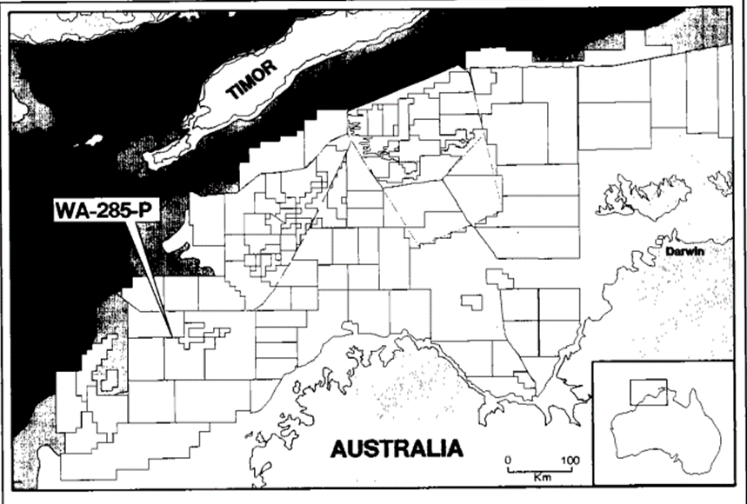
.
.

Slide 4
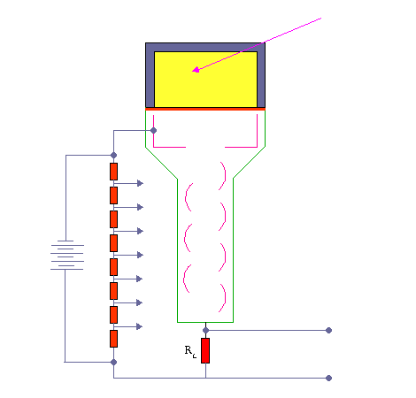

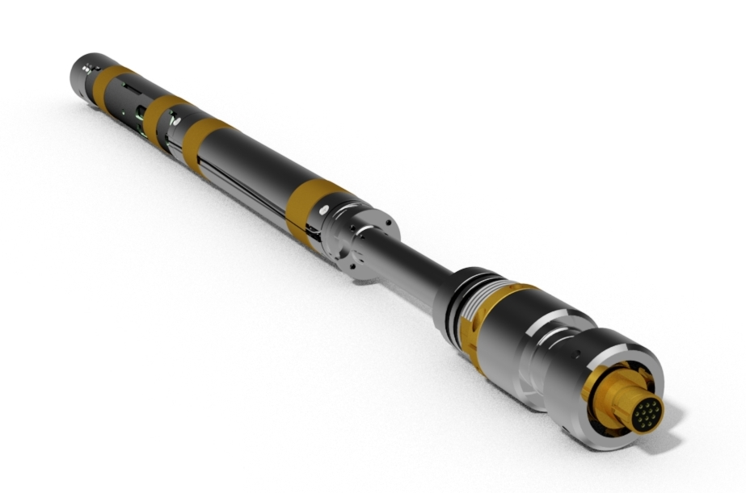
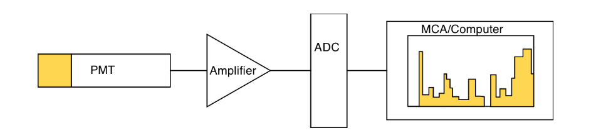
Gamma Ray Tool Instrumentation
GAMMA RAY TOOL DESIGN
GAMMA RAY TOOL COMPONENTS
NUCLEAR RADIATION DETECTOR : Scintillation Counter
Gamma Ray Tool
Preferred gamma detector : Scintillation counter .
High sensitivity, robustness, Economic, and ease of use in the harsh environments.
ELECTRONICS AND DATA ACQUISITION

Slide 5
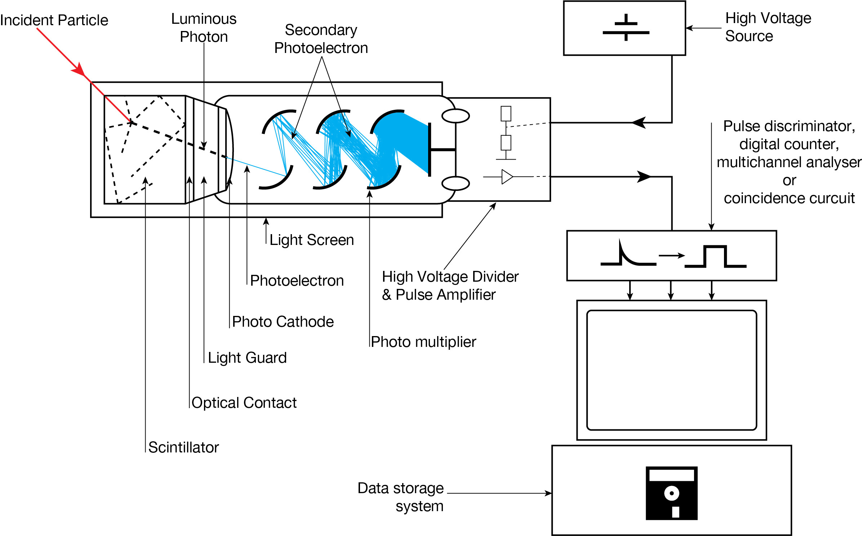
WORKING OF SCINTILLATION COUNTER
SCINTILLATION MEDIUM
NaI(Tl) crystal as scintillation material.
high light output efficiency, high spectral resolution, and high gamma ray absorption properties.
PHOTO CATHODE
Cs or Sb as photo cathode.
low work function, high sensitivity, and broad spectral response.
PHOTO MULTIPLIER TUBE
Dynodes : Au or Cu , coated with metal oxide (electron multiplier material).
High secondary electron emission & good stability.
DIGITAL PULSE COUNTER
Multi Channel Analyzer(MCA)
Ability to handle good count rate. without saturating the data.
Wide dynamic range.
Higher resolution.

Slide 6
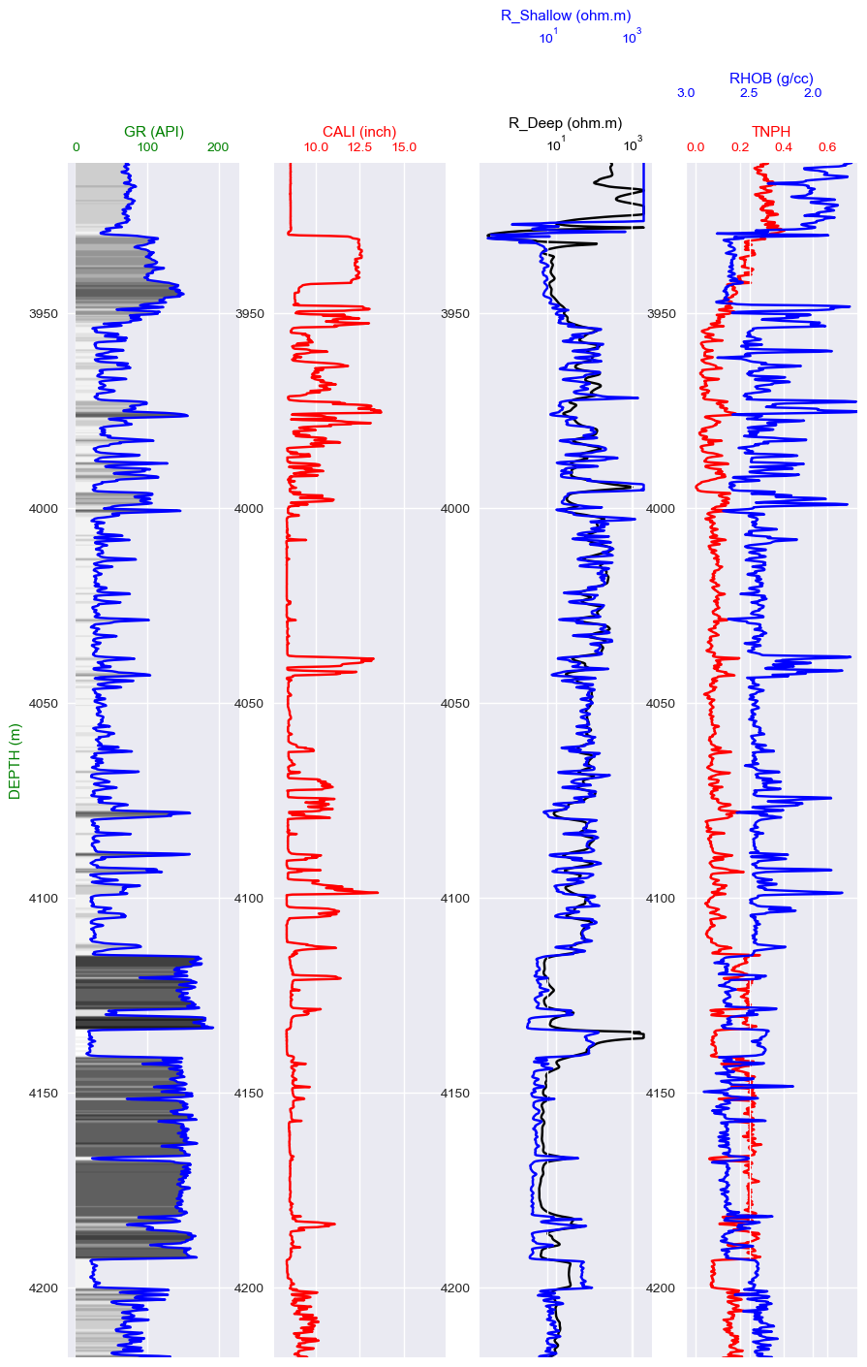
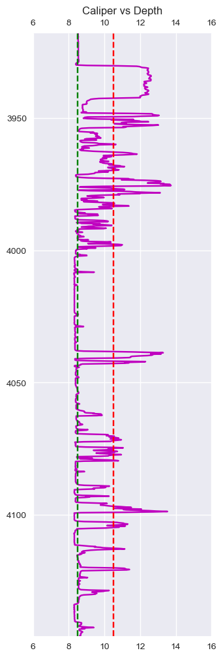
QUALITY CONTROL & MARKING OBVIOUS OUTLIERS
Marking Outliers
Bit Size = 8.5 inch.
The borehole will be called bad borehole if the the Calliper size is 2 inch greater then the bit size.

Slide 7
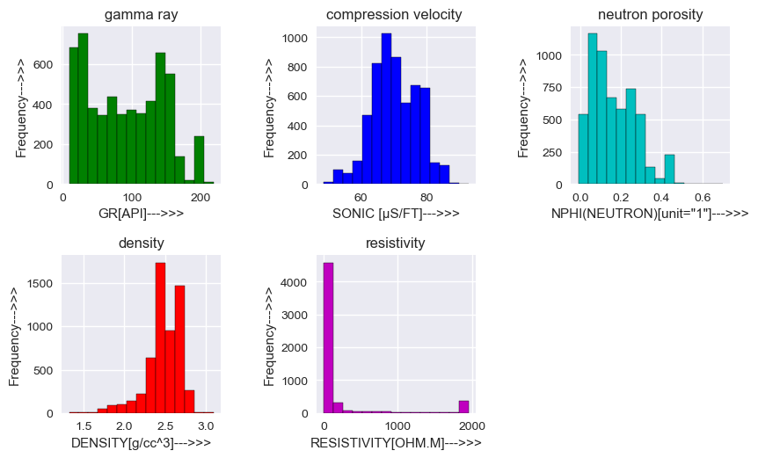
QUALITY CONTROL & MARKING OBVIOUS OUTLIERS
From the Histogram of Density plot(RHOB), some outliers are detected.
From the Histogram of Neutron Porosity plot(NPHI), some outliers are detected.
Histogram Plots of Brewster Member Formation

Slide 8
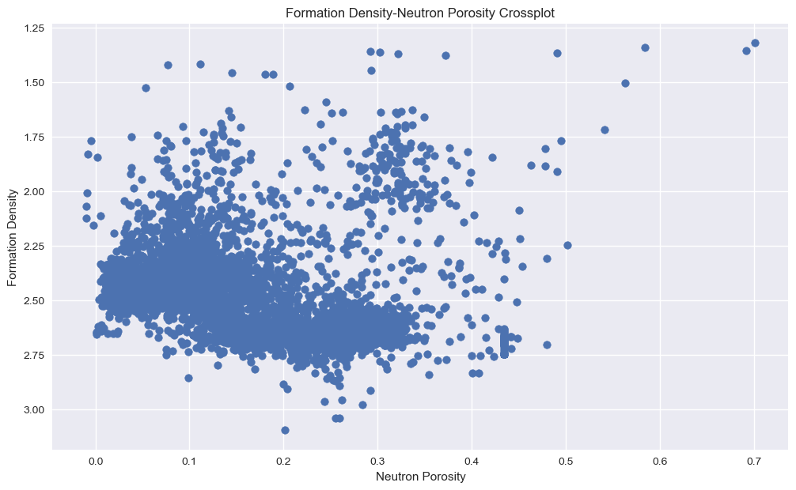
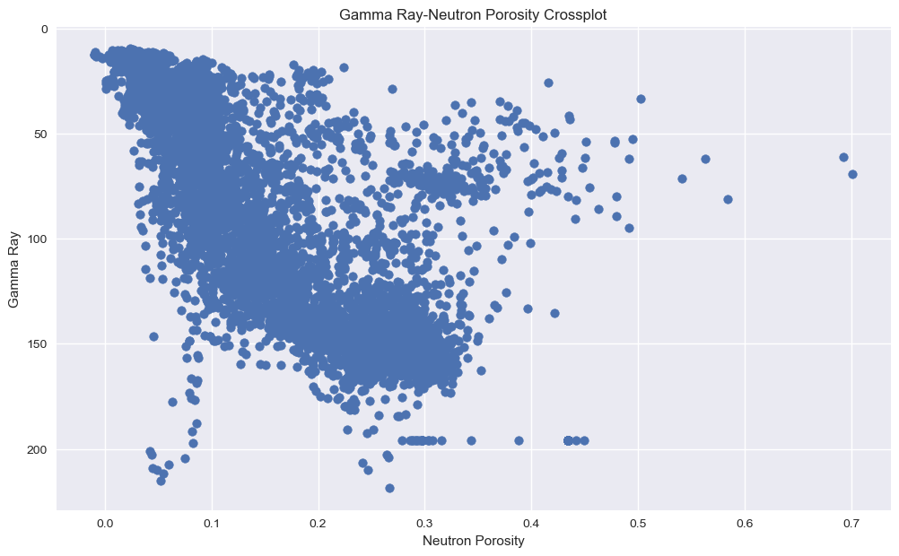
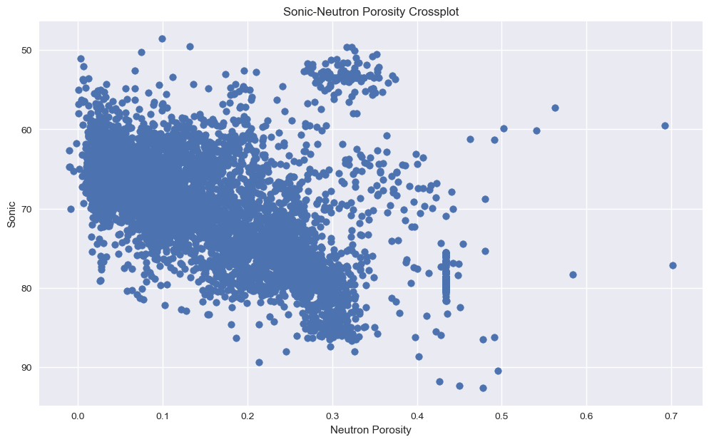
QUALITY CONTROL & MARKING OBVIOUS OUTLIERS
Outliers
PairPlots

Slide 9
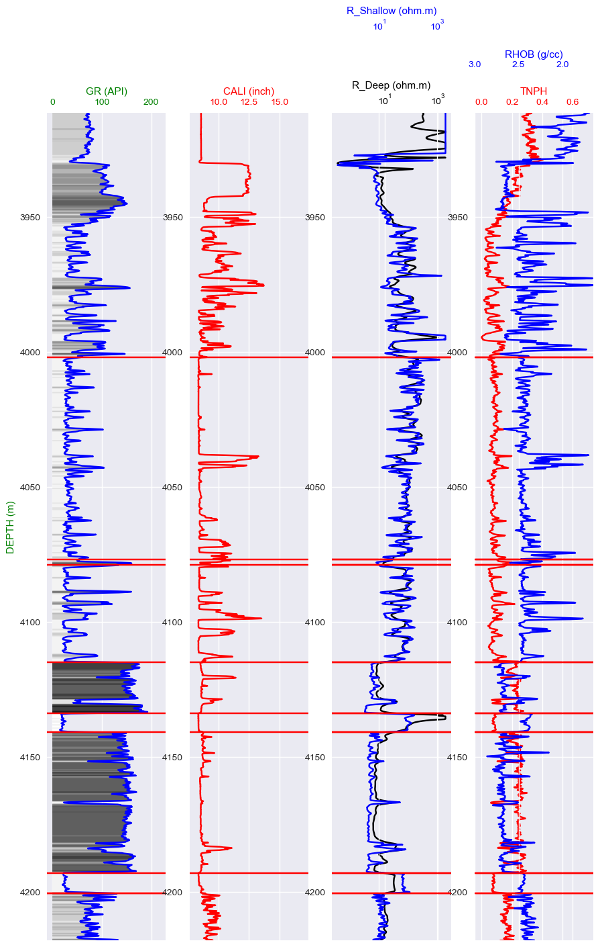
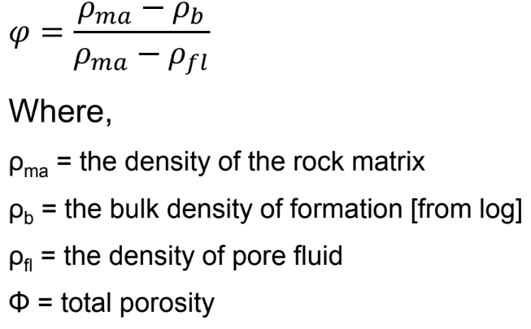
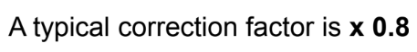
CALCULATION OF TOTAL POROSITY AND IDENTIFYING HIGHEST POROSITY ZONE
At first, we detected the gas bearing zones by comparing different logs.
Then, we calculated density porosity using the formula given below:
Fluid Density=0.8 gm/cc
Gas Bearing Zones
Applied Gas Correction to the Density porosity.

Slide 10
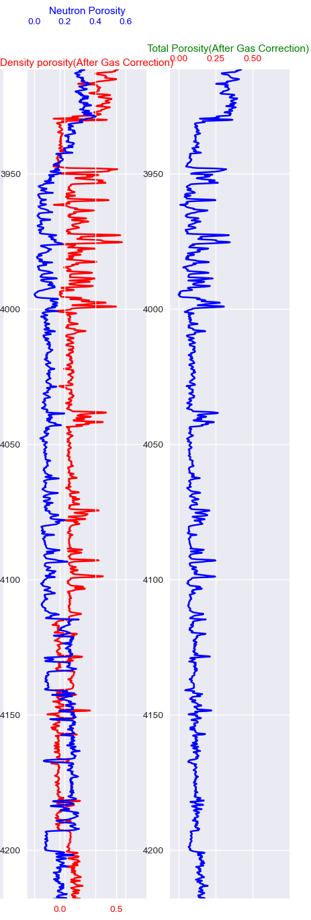
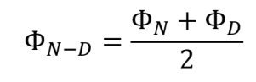
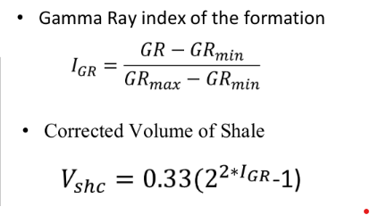
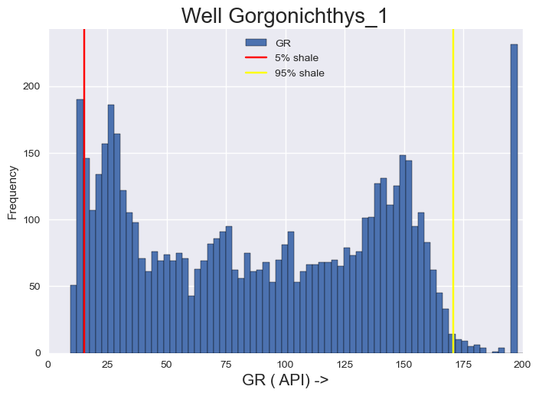
CALCULATION OF TOTAL POROSITY & IDENTIFYING HIGHEST POROSITY ZONE
Then we computed Total Porosity using the formula below:
Highest Porosity Zone
Plot of total porosity with depth
Volume of Shale(Vsh) Calculation:
The maximum GR value= 170.7985
The minimum GR value= 15.3999

Slide 11
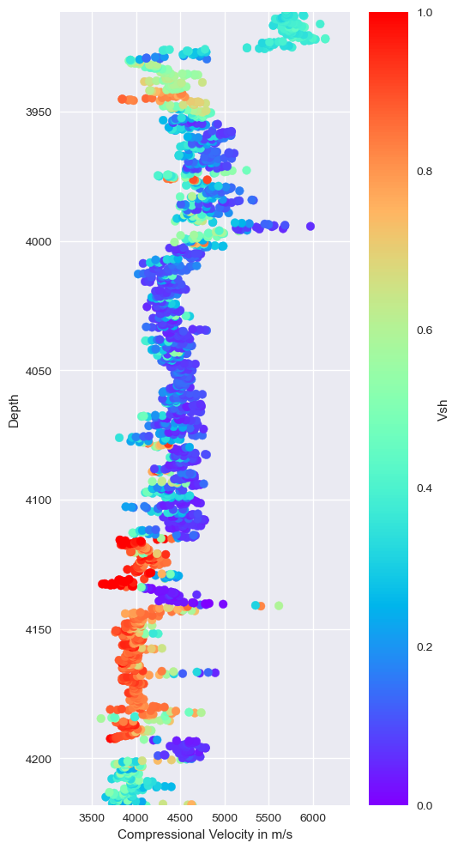
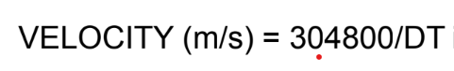
COLOUR CODED COMPRESSIONAL VELOCITY VS DEPTH PROFILE
Colour Coded Velocity Depth Profile with Volume of Shale

Slide 12
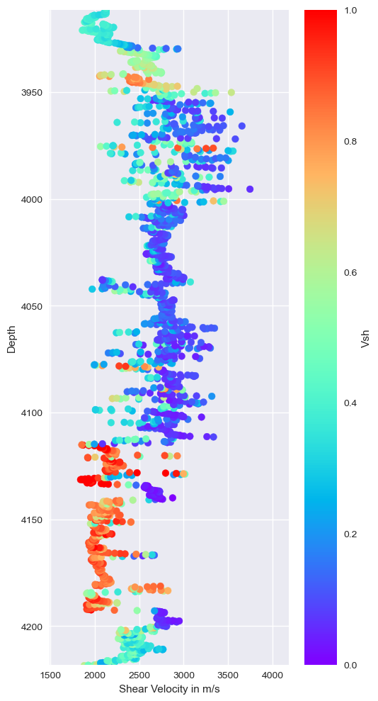
COLOUR CODED SHEAR VELOCITY VS DEPTH PROFILE
Colour Coded Velocity Depth Profile with Volume of Shale

Slide 13
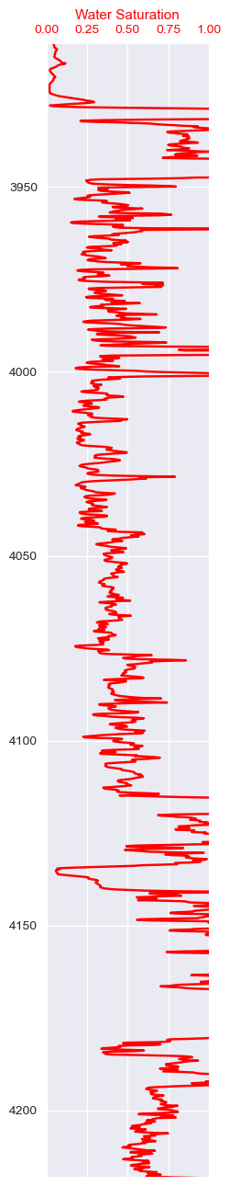
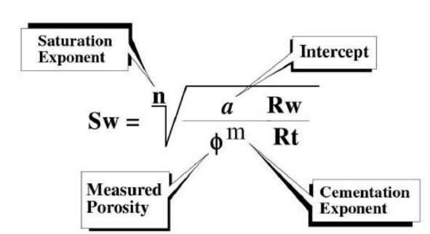
CALCULATION OF WATER SATURATION:
Archie’s Formula(1942):
Here, we used
Tortuosity Factor=1
Cementation exponent=1.8
Saturation Exponent=2
Water Saturation variation with depth from Archie’s Equation

Slide 14
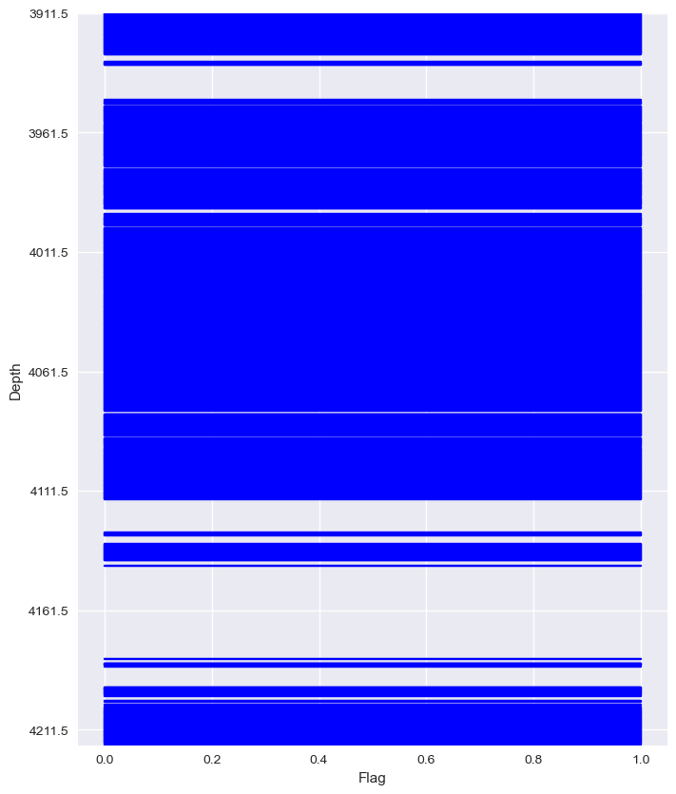
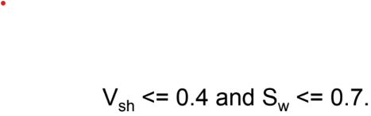
GENERATION OF RESERVOIR FLAG:
The Reservoir Zones

Slide 15
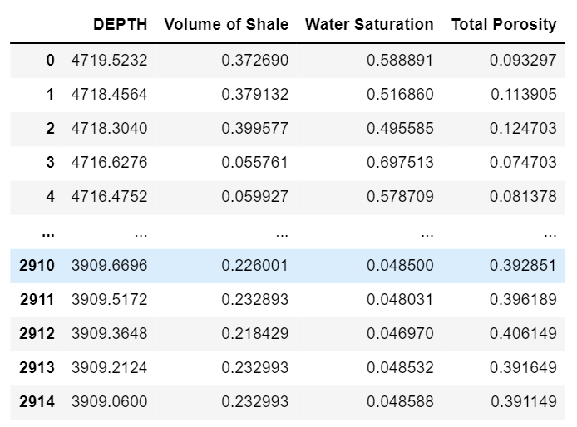
CALCULATION OF TOTAL POROSITY,WATER SATURATION & VOLUME OF SHALE

Slide 16
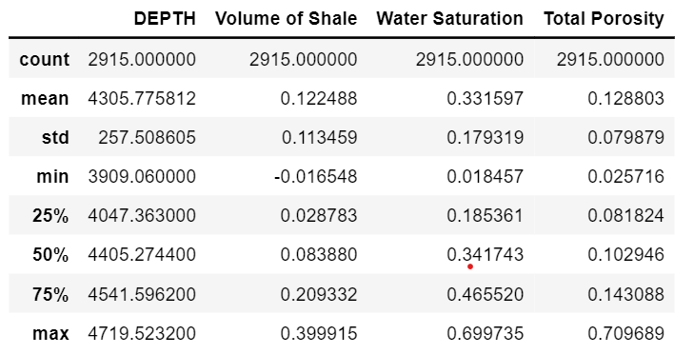
STANDARD DEVIATION OF PARAMETERS OF RESERVOIR ZONE:

Slide 17
References:
Richard M. Bateman - Openhole Log Analysis and Formation Evaluation-Society of Petroleum Engineers (2012)
Fundamentals of Well Log Interpretation - O'Serra
Scintillation counter – Wikipedia
22. Scintillation Detector — Modern Lab Experiments documentation (fiu.edu)
https://www.britannica.com/science/Berriasian-Stage
https://www.britannica.com/science/Berriasian-Stage

Slide 18
Thank You

